Slide 1
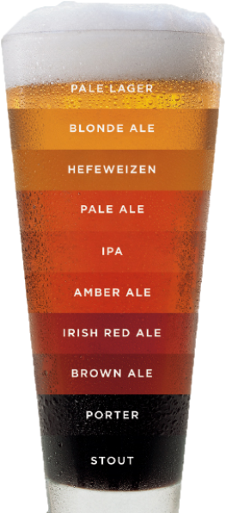
Brewery Investigation in the United States
Duy Nguyen & Garrett Shankel
Notes:
Hello Mr Whitworth and Mr Canton, thank you for taking the time to meet with us. We have done quite a bit of work with the data that your teams have provided us with, and we believe our findings will be of great interest to you.

Slide 2
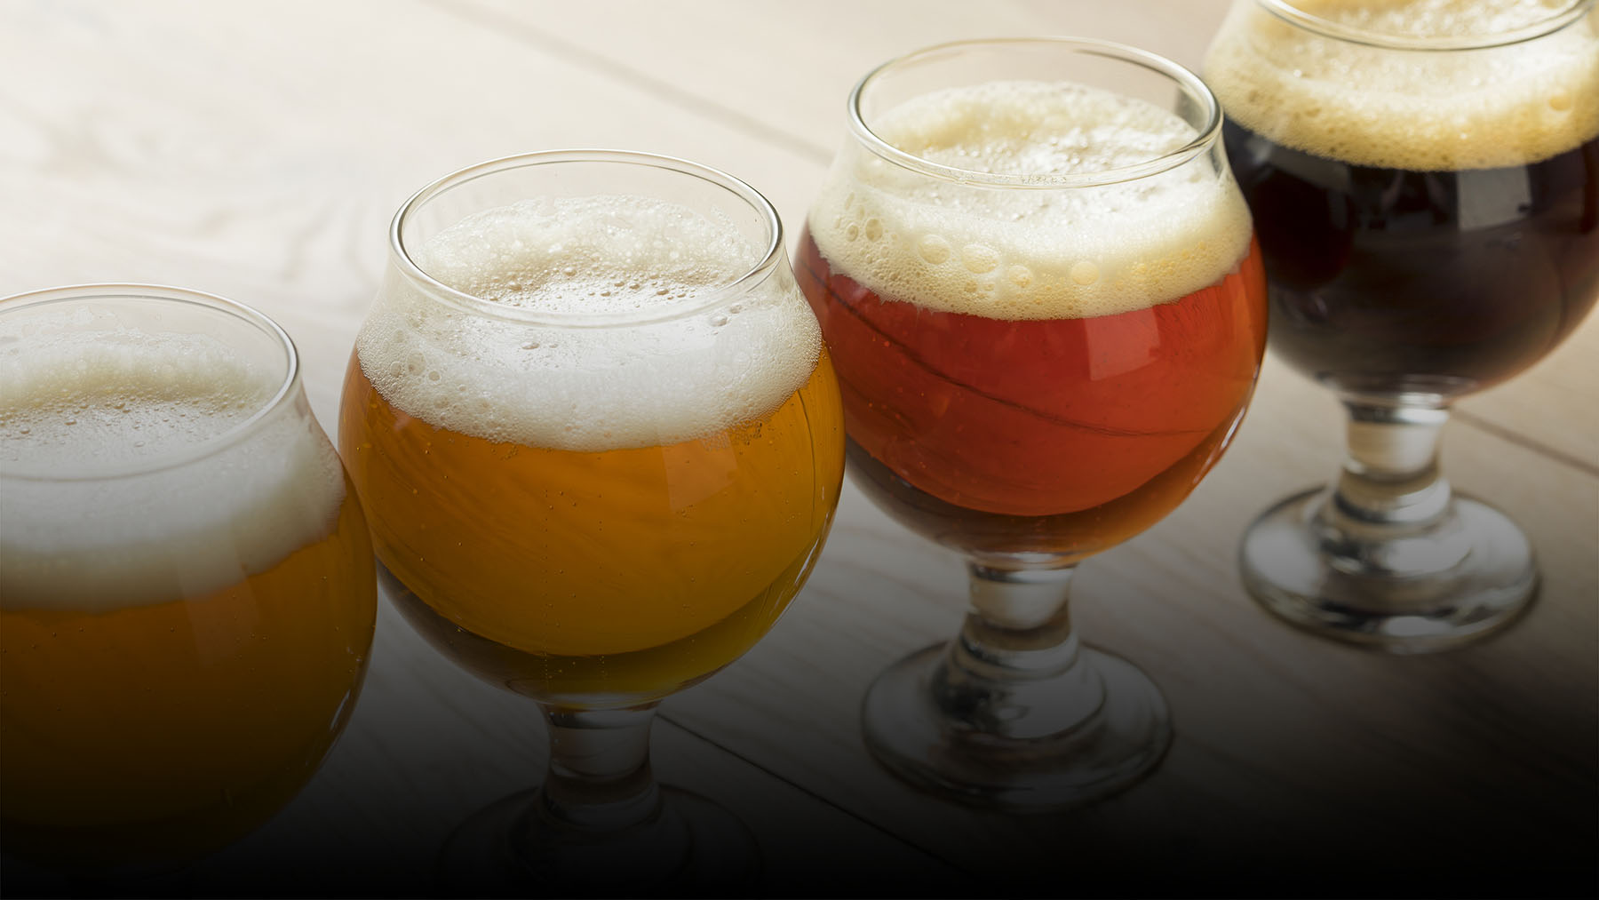
Scope of Discussion
Overview of Data Used
Brewery Count per State in the US
Beer Descriptors per State
Nationwide Statistics of ABV
Relationship between ABV and IBU
Notes:
We would like to do a high level overview of the things we’ve discovered in our analysis. First we’ll walk through…

Slide 3
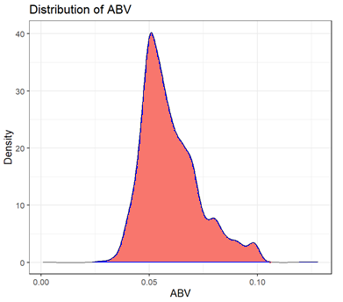
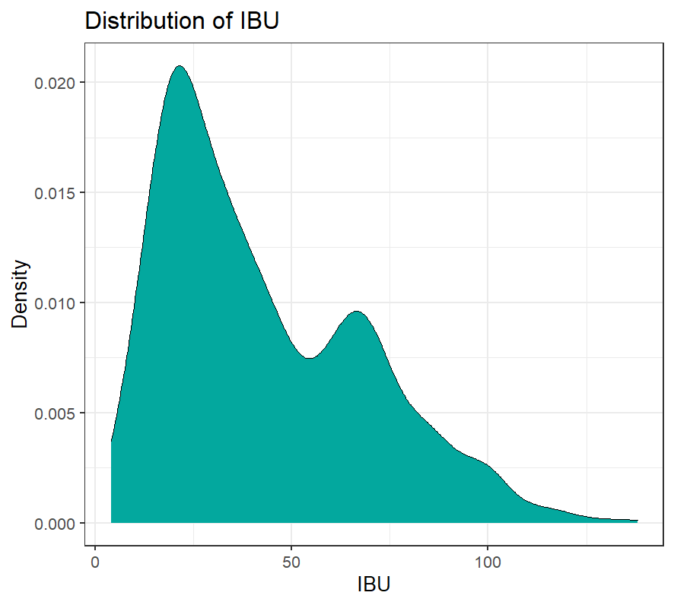
Overview of Data Used
Missing Values in Beers and Brewery Data
Out of a total of 2410 entries in the beers data set:
62 entries were missing for ABV
1005 entries were missing for IBU
Two inferences had to be made on ABV and IBU in order to complete the dataset
A plot of ABV’s data shows that its values are normally distributed. Therefore, any missing values were replaced with the mean of the ABV data.
A plot of the IBU data shows that its values are heavily right skewed. Therefore, any missing values were replaced with the median of the IBU data.

Slide 4
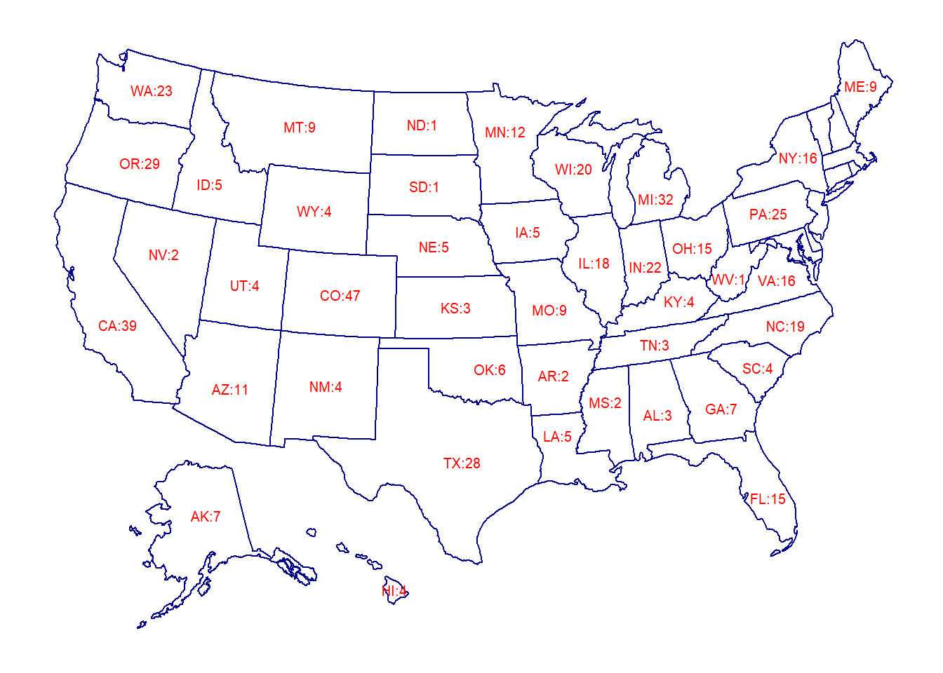
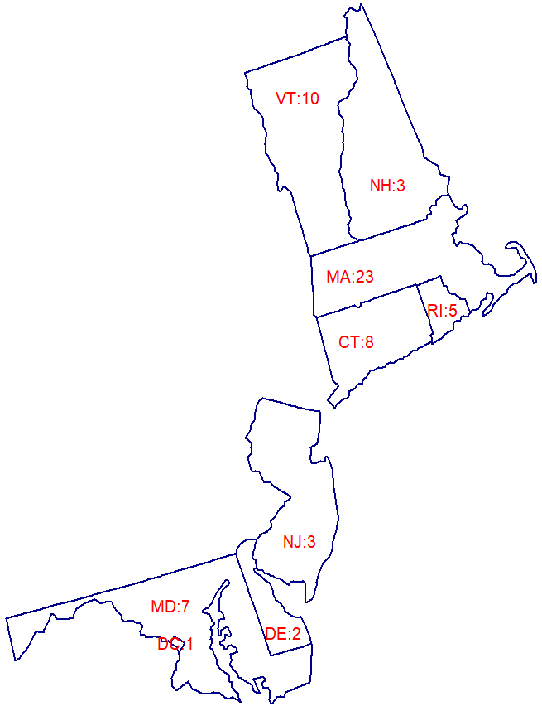
Brewery Count per State
Top 5 States
Colorado (CO) | 47
California (CA) | 39
Michigan (MI) | 32
Oregon (OR) | 29
Texas (TX) | 28

Slide 5
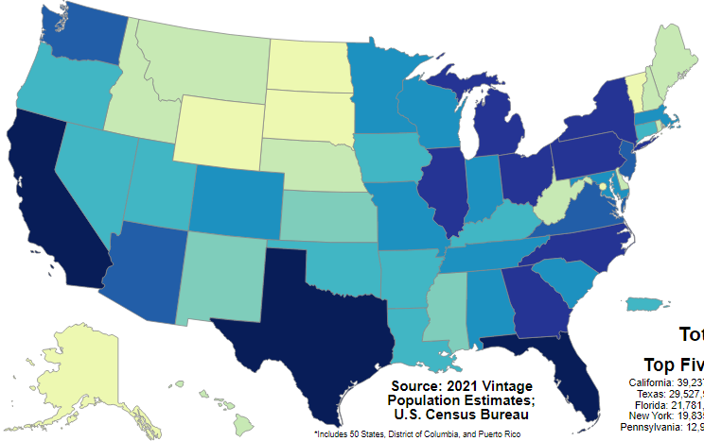
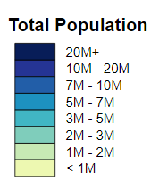
Population Count per State

Slide 6
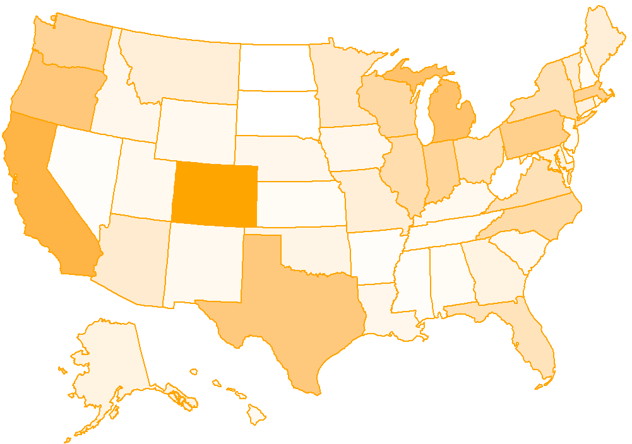
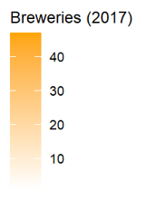
Brewery Density per State
Notes:
We found density to be another interesting descriptor about breweries in states. For example we can see that the brewery to population density in Tennessee is very low. For the roughly 7 million people in Tennessee there are only 3 breweries to service them. This could be a potential state for expansion. Or possibly new jersey with a ratio of 1 brewery to every 3 million people

Slide 7
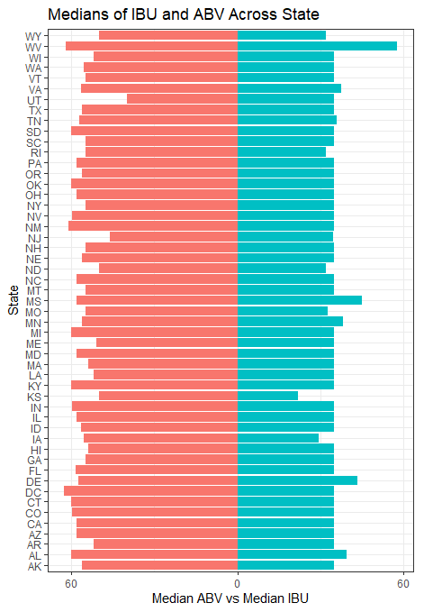
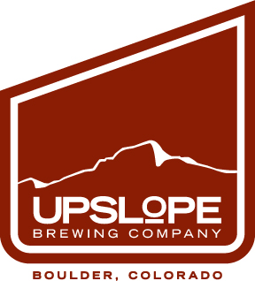

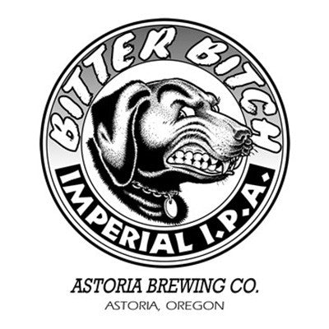
Beer Descriptors per State
ABV versus IBU
Maximum Alcohol by Volume:
Beer: Lee Hill Series Vol. 5
Brewery: Upslope Brewing Company
State: Colorado
Washington DC has the highest median ABV.
Maximum International Bitterness Unit:
Beer: Bitter Bitch Imperial IPA
Brewery: Astoria Brewing Company
State: Oregon
West Virginia has the highest median IBU.

Slide 8
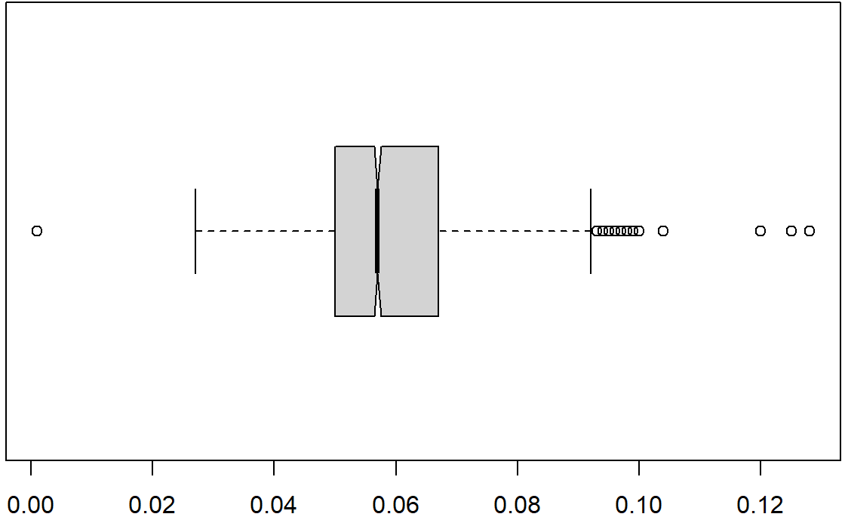
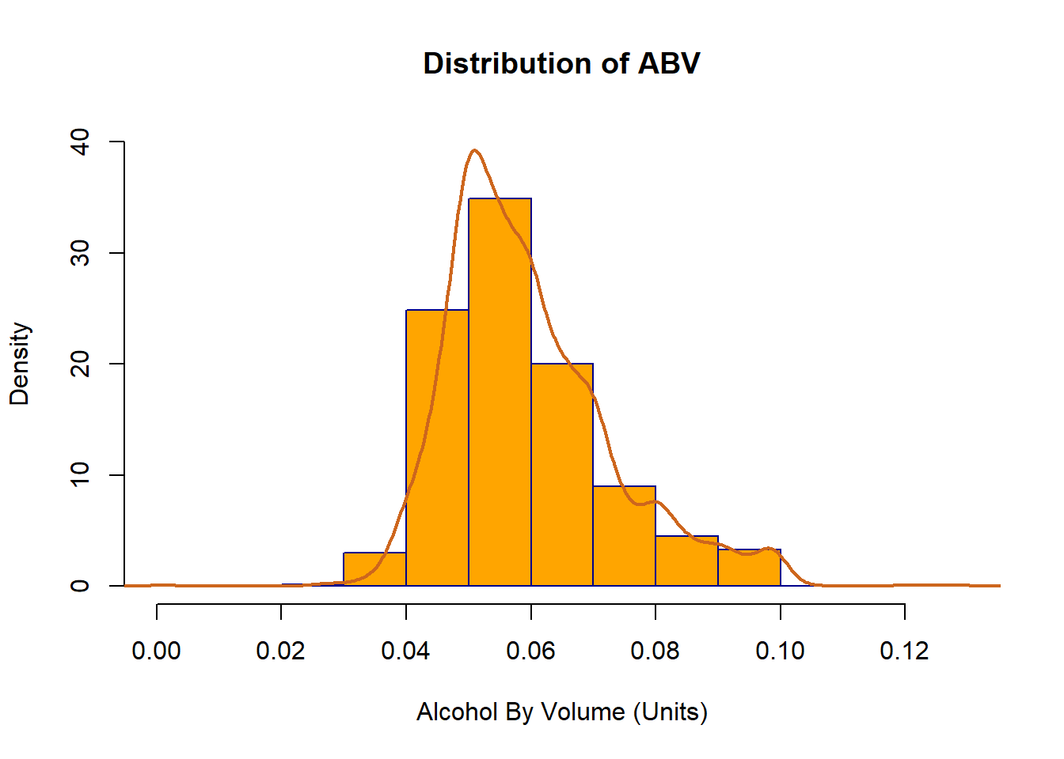
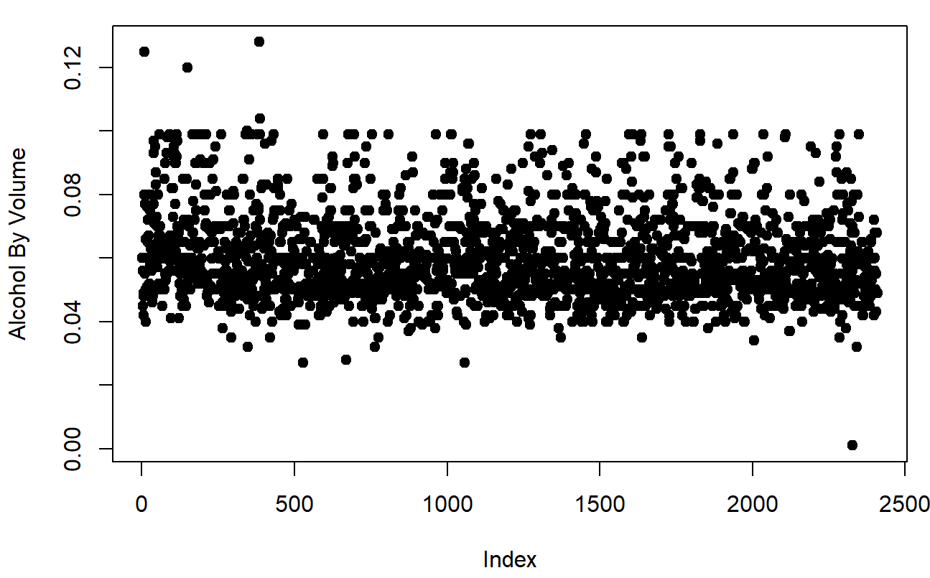
Nationwide Statistics
Boxplot Version
Alcohol by Volume (Units)
Observations: 2410
Mean: 0.05977
Median: 0.05700
SD: 0.01336
1st Quarter: 0.05000
3rd Quarter: 0.06700
Scatterplot Version

Slide 9
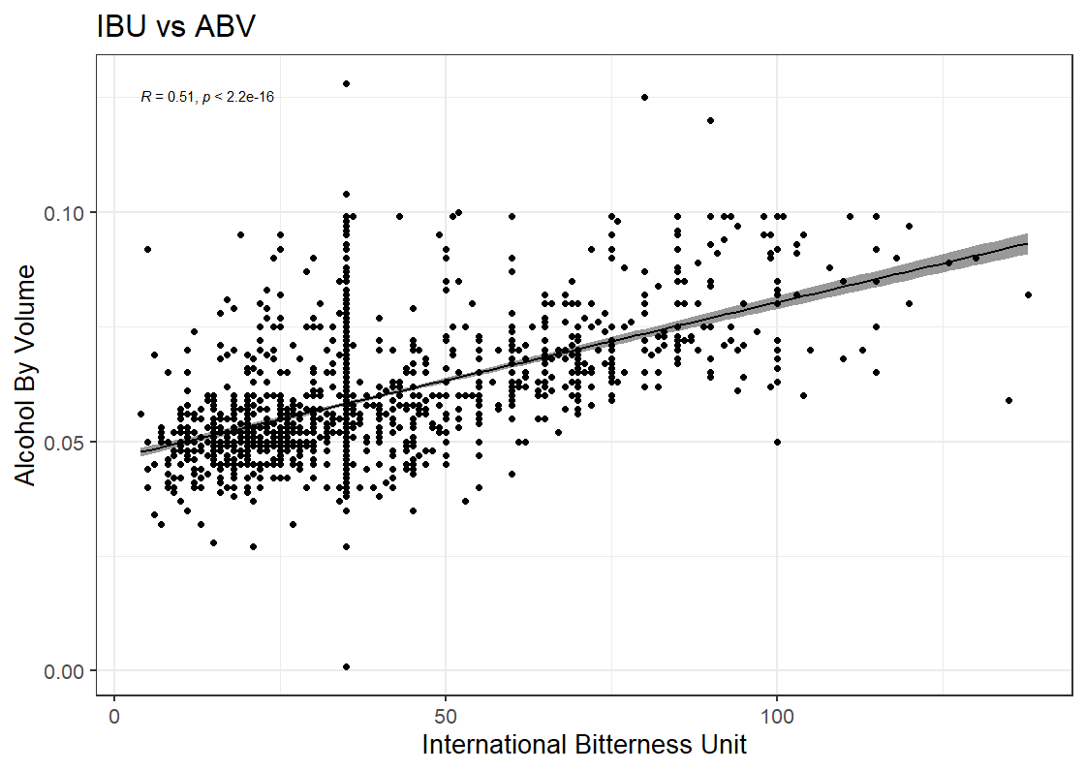
Relationship between ABV and IBU
Notes:
Needs more detail. One or two more points

Slide 10
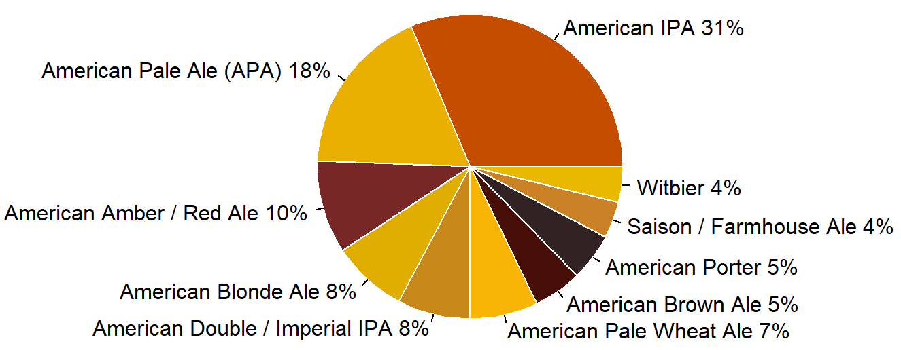
Top 10 Beer Styles
Notes:
Needs more detail. One or two more points

Slide 11
Thank You.
Duy Nguyen & Garrett Shankel
duynq@mail.smu.edu
gshankel@mail.smu.edu

Slide 12
Presentation Video Link
Notes:
Needs more detail. One or two more points

